Slide 1
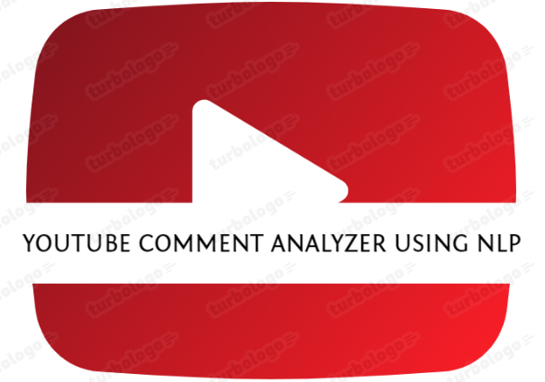

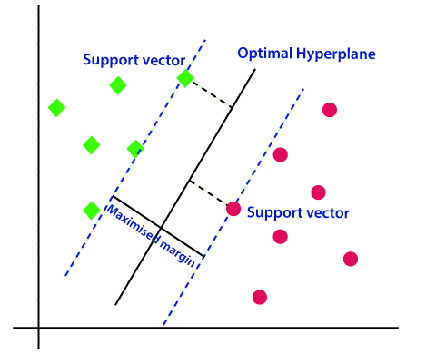
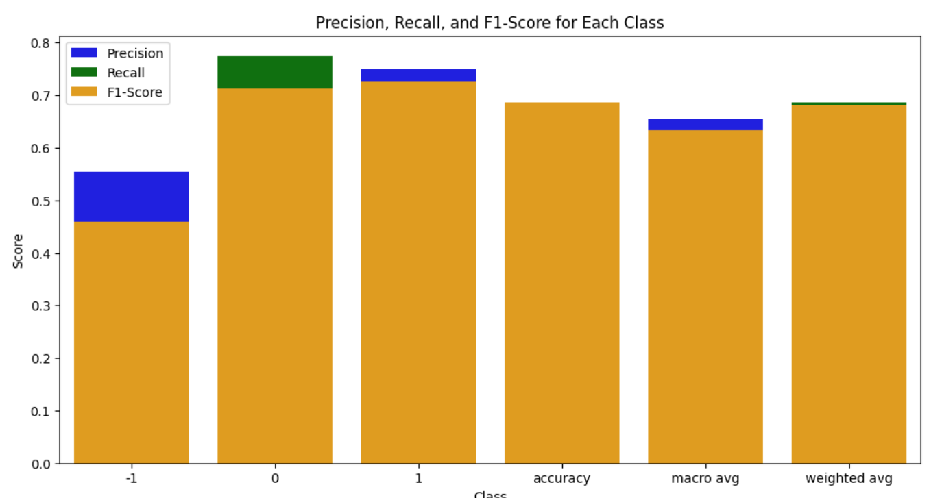
X
YouTube Comment Analyzer Using Natural Language Processing
Introduction
SVM Model For Comment Analysis
Different Accuracies
Introduction
Introduction
Introduction

